Slide 1
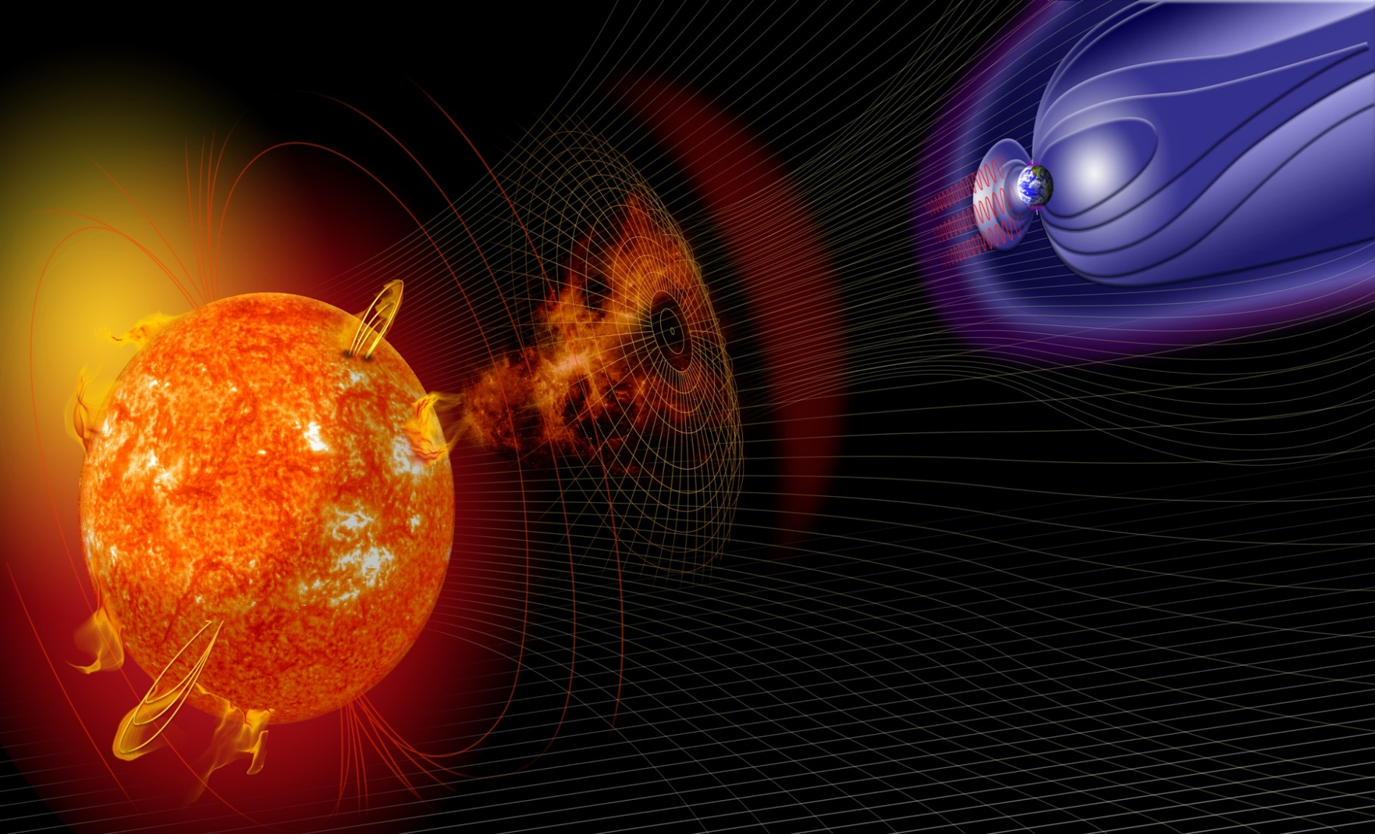
Satellite Observations for Space Weather Forecasting
Zahra Bouya
Australian Bureau of Meteorology, Space Weather Services
Earth Observation Australia webinar, March 19, 2020

Slide 2
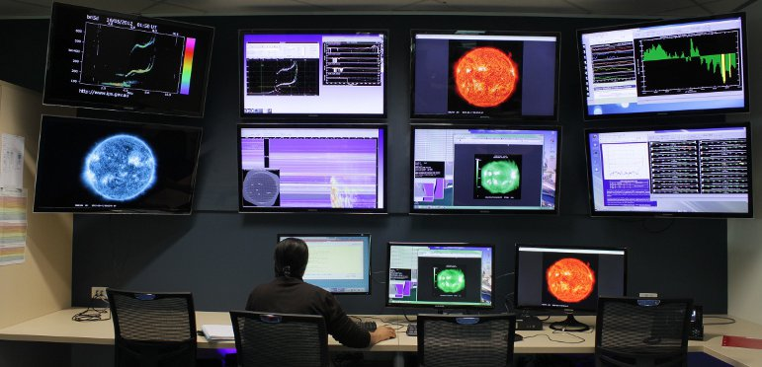
Australian Bureau of Meteorology Space Weather Services www.sws.bom.gov.au
- Originally Ionospheric Prediction Service (IPS) providing HF Radio services and support since late 1940's
- Joined Australian Bureau of Meteorology 2008
- Became Space Weather Services section of Hazards Prediction Branch in July 2014
- ISES Regional Warning Centre
(RWC) Australia
- Operate the Australian Space
Forecast Centre (ASFC)

Slide 3
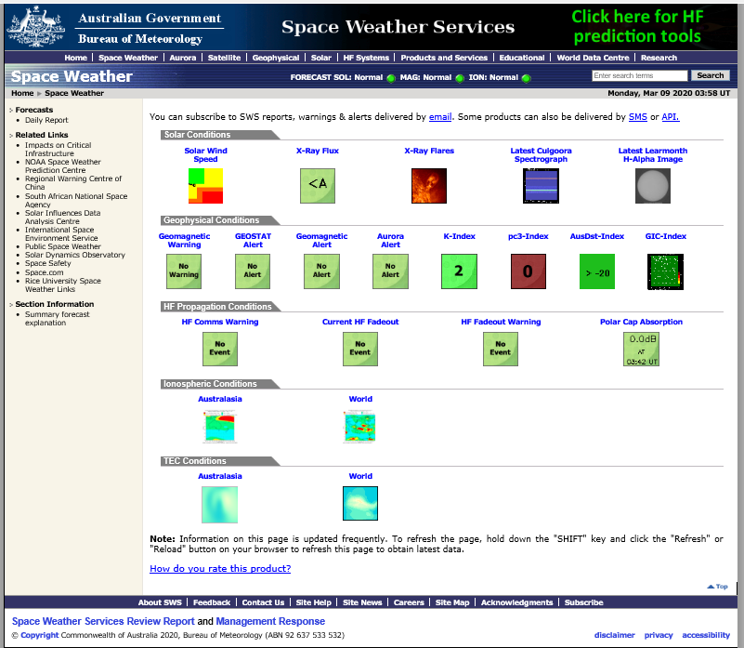
Australian Bureau of Meteorology Space Weather Services www.sws.bom.gov.au
Solar
Geomagnetic
High-Frequency radio
Ionosphere
TEC-GPS
- Data sets in near-real-time from a variety of sources, ranging from solar imaging satellites to ground based stations.
- SWS utilizes an array of observed data sets in operations and related research.

Slide 4
Sun – Earth Connection
CREDIT: NASA

Slide 5
Solar Observations
Events of interest:
Flares, Coronal Mass Ejections, Energetic Particles
Images courtesy of NASA and ESA

Slide 6
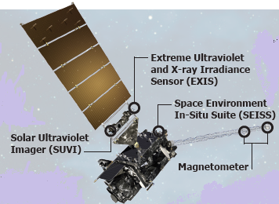
Solar Observations
The Geostationary Operational Environmental Satellite (GOES)
-SUVI: Observes complex active regions, solar flares, and eruptions of solar filaments.
-EXIS: Detects solar flares and monitors solar irradiance that impacts the upper atmosphere.
-SEISS: Monitors proton, electron and heavy ion fluxes in the magnetosphere.
-Magnetometer: Measures the magnetic field in the outer portion of the magnetosphere.
Image courtesy of NASA

Slide 7
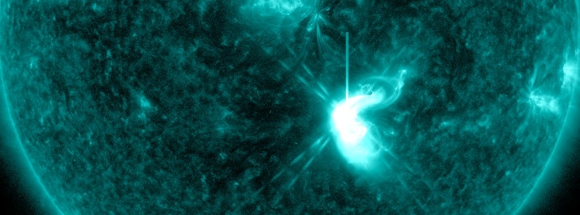
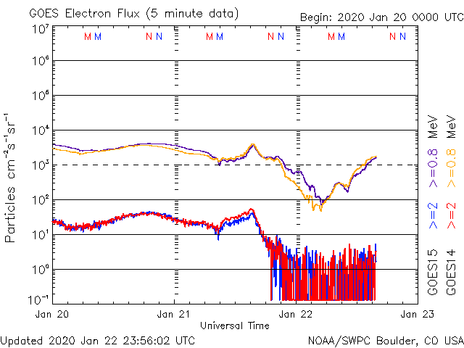
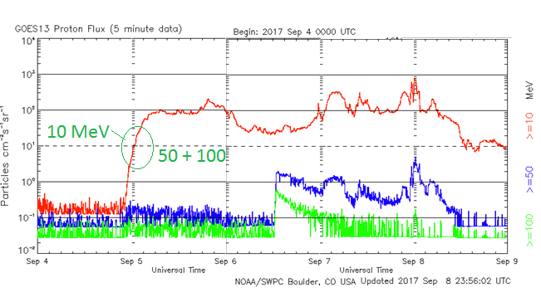
Solar Observations
GOES: X-rays flux and High Energy Particles
Xray High Energy Electrons High Energy Protons

Slide 8
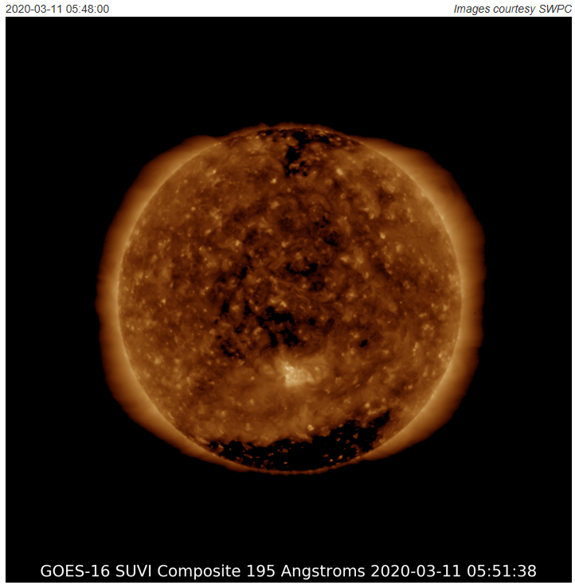
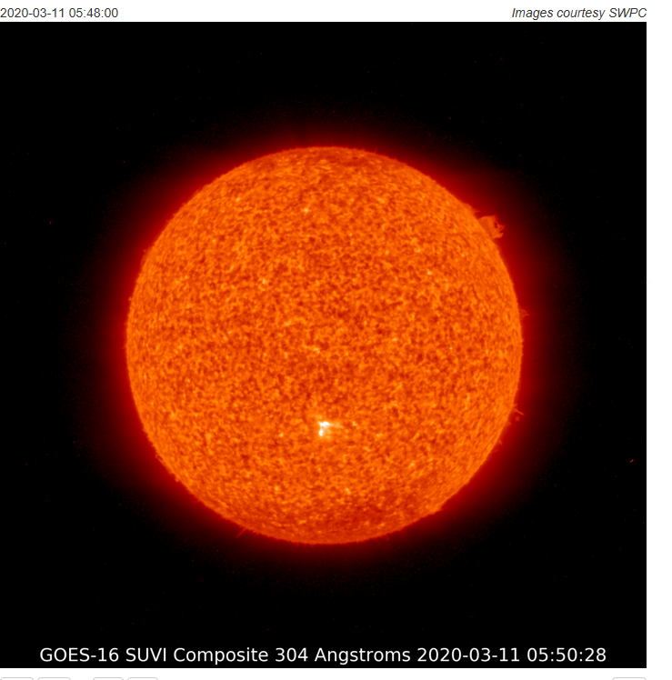
Solar Observations
Recent Images from GOES 16 SUVI instrument :
Composite 195 and 304 Angstroms
CREDIT: NASA
CREDIT: NASA
Notes:
SDO(backup)

Slide 9
NASA Solar Dynamics Observatory (SDO)
Solar Observations
- SDO is the first mission to provide full-sun imaging of the Sun
- Launched in February, 2010
- All instruments are fully operational
- ~ 2 T byte/day of data
Instruments:
- High Resolution Imager (HRI)
- Atmospheric Imaging Array (AIA) uses 4 telescopes
-Extreme Ultraviolet Variability Experiment (EVE)
Image courtesy of NASA

Slide 10
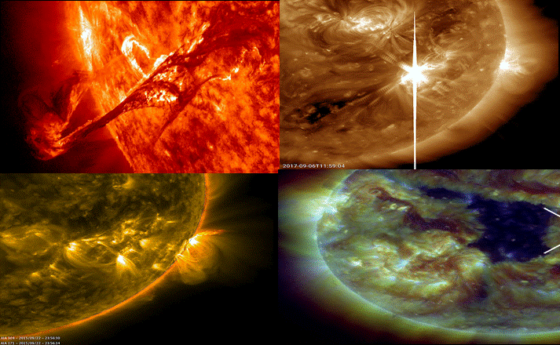
Sun Observations
Images from SDO Instrumentsof the Sun in many different wavelengths:
-Active Regions (AR)s, Coronal Holes (CH)s, solar flares and filaments.
Images courtesy of NASA

Slide 11
Solar Observations
Solar and Heliospheric Observatory(SOHO)
-Cooperative project between ESA and NASA
-Spacecraft located at the Lagrange L1 point
1.5 x 10⁶ km from Earth
-Launched in December, 1995
-Still operating
Images courtesy of NASA&ESA

Slide 12
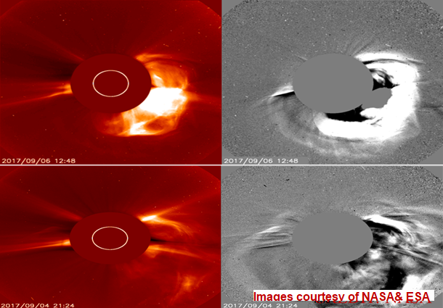
Solar Observations
SOHO
- Solar images
- Coronal Mass Ejection (CME)

Slide 13
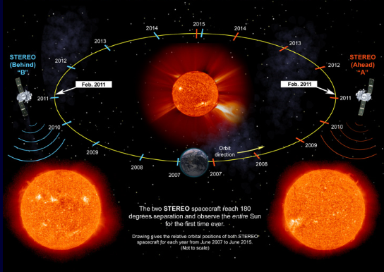
Solar Terrestrial Relations Observatory (STEREO)
Solar Observations
-Two identical spacecraft leading and following the Earth
- Launch - October, 2006
-Four instrument packages
-Goal:
Understand the origin and consequences of CMEs
Image courtesy of NASA
32

Slide 14
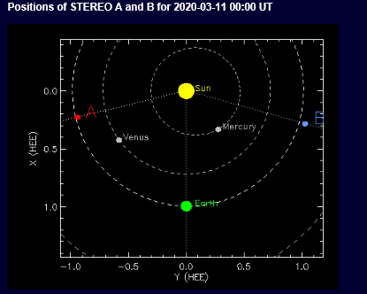
STEREO Spacecraft Positions:
Solar Observations
-On 11th March 2020, positions were with 151.153 degree separation
71⁰
79⁰
Image courtesy of NASA
-To see the positions at any time go to: http://stereo-ssc.nascom.nasa.gov/where/

Slide 15
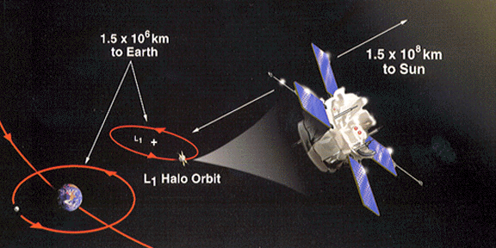
Solar Observations
Advanced Composition Explorer (ACE)
- NASA mission to study solar wind and CMEs
- Located at the Lagrange L1 point between Earth and Sun
- Launched in August, 1997,
- Still operating has fuel to continue at L1 until ~ 2024
- Nine instruments to sample the arriving Solar Wind and CME plasma close to Earth.
In-situ:
- Element composition and ion state
- Plasma velocity
- Particle energies
- Magnetic field
Deep Space Climate Observatory (DSCOVR)
- DSCOVR satellite is the primary source of real time solar wind and interplanetary magnetic field data.
- Aged ACE satellite (22 years old) is used as a backup.
Image courtesy of NASA

Slide 16
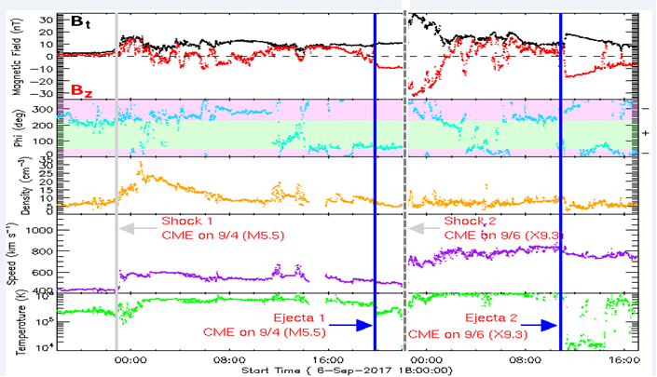
Solar Observations
ACE/ DSCOVR
- Remote sensing from Lagrange point
- Global environment at Earth
Vsw, IMF Bz, CME shocks
CME shock arrival: 22:30 UT on 07 September 2017.

Slide 17
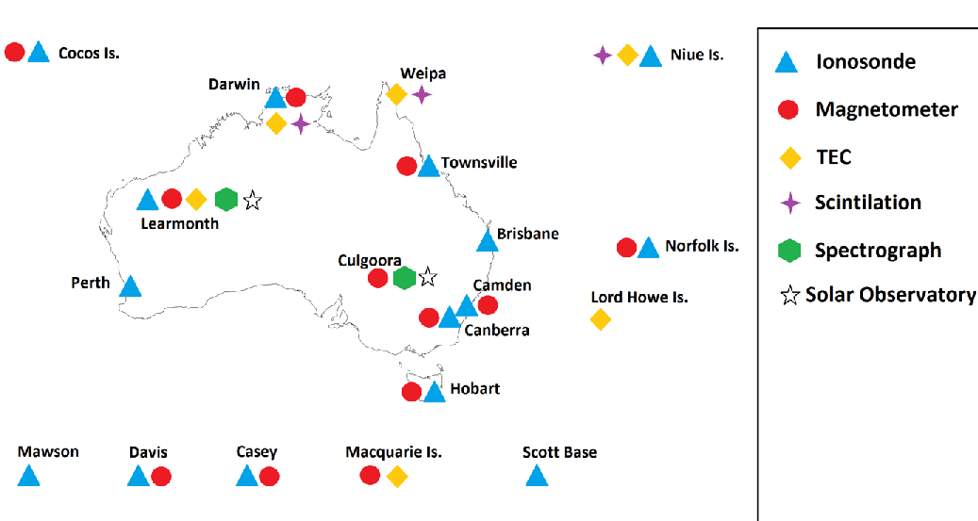
Space Weather Sensor Network

Slide 18
Thank you
Z.Bouya@bom.gov.au

